Slide 1

Prepared for Graham’s Pharmacy
Dynamic Consulting
Team 39-Colton Labou, Kat Craats, Lexi Vagar, Roy Rao, David Smith
Cohort 4
10/04/2018
Notes:
Please note the size and colour contrast. The client is the most important so their name is the largest with high contrast
Size and Contrast = Importance
Colour is anything BUT red. Keel this as your theme colour throughout

Slide 2
Our solution will help your Pharmacy keep traditional methods and market effectively to capture more unique market share.
Outcomes
Notes:
For blocks of text greater than 1 line, please expand the text by 0.5pt

Slide 3
Executive Summary:
Traditional Pharmacy with retro aesthetic
Kingston, ON in 2012
“Focus on dispensing medications, using the most modern methods available, and establishing a relationship with clients to help promote their health”

Slide 4
Primary Issues
Secondary Issues
Problem Identification Analysis Recommendations Implementation Q+A

Slide 5
Primary Issues
Secondary Issues
Ineffective Marketing Strategies
Problem Identification Analysis Recommendations Implementation Q+A

Slide 6
Primary Issues
Secondary Issues
Ineffective Marketing Strategies
Profitability
Problem Identification Analysis Recommendations Implementation Q+A

Slide 7
Primary Issues
Secondary Issues
If these are not solved, the business will see significant troubles
Problem Identification Analysis Recommendations Implementation Q+A

Slide 8
Opportunities
Weaknesses
Strengths
Threats
Problem Identification Analysis Recommendations Implementation Q+A

Slide 9
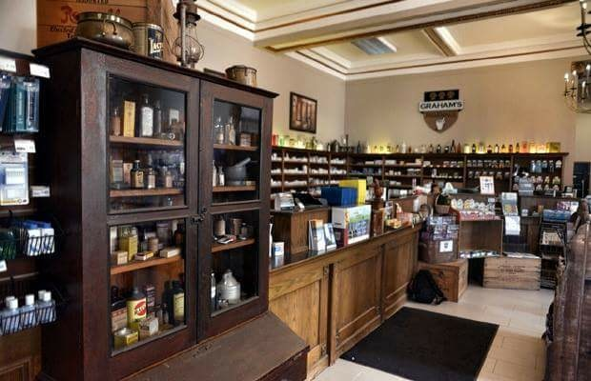
 | Strengths: Customer Experience Historic Location Industry Knowledge Competitive Pricing | Weaknesses: Lack of Collaboration Store Layout Brand Recognition
Implications: | Personal connections = loyalty More customer foot traffic Efficient practices Higher profit margins | Decreased sales Surface level connections Ineffective marketing
Strategy: | Great customer service with specialized products and place branding | Change marketing campaign via positioning Utilize store layout resourcefully
Problem Identification Analysis Recommendations Implementation Q+A
Notes:
Quantitative: Stats, Growth Rate, Size, #of competitors,

Slide 10
 | Opportunities: Increased revenue Capitalization Front Of House (FOH) Products Additional Services | Threats: Large Corp Competitors Changing Job and Demographic Increased Drug Costs
Implications: | Increased market share and cash flow | Operational challenges and increased expenses
Strategy: | Strong retail merchandising Market research Competitive pricing | Increase revenue through customer pricing Change target market
Problem Identification Analysis Recommendations Implementation Q+A
Notes:
Quantitative: Stats, Growth Rate, Size, #of competitors,

Slide 11
Specialize
Collaborate
Loyalty
Problem Identification Analysis Recommendations Implementation Q+A

Slide 12
Specialize
Diabetes care
Utilize experience and knowledge
Offer specialized service and care
Keep founder values
Focus on quality over quantity
Potentially narrows target demographic
Problem Identification Analysis Recommendations Implementation Q+A

Slide 13
Collaborate
Ad through flyers
Talk to walk in clinics/Go mobile
Free health tests in store
Community presence
Costly
More brand recognition
Problem Identification Analysis Recommendations Implementation Q+A

Slide 14
Loyalty
Points, Price, Prominence (stamp card, some tech)
Customer discounts, annual fee
All demographics
Profitable, cost effective
Problem Identification Analysis Recommendations Implementation Q+A

Slide 15
Criteria | Weight | Local | Incorporate | Loyalty
Profit | 25% | 3 | 1 | 5
Customer Share | 35% | 4 | 3 | 4
Ease of Implementation | 20% | 3 | 1 | 4
Time | 20% | 2 | 1 | 4
Totals | 100% | 3.15 | 1.70 | 4.25
Problem Identification Analysis Recommendations Implementation Q+A

Slide 16
Loyalty
Local
Collaborate
Problem Identification Analysis Recommendations Implementation Q+A
Notes:
Optional Slide

Slide 17
Success = “Know What” + “Know How”
Details about Implementation:
Cost: $10,000 tech/RBLink app
$10,000 short run discount offsets
= $20,000 net cost
Risks: Lose customers, Value change, Declining profits
Problem Identification Analysis Recommendations Implementation Q+A

Slide 18
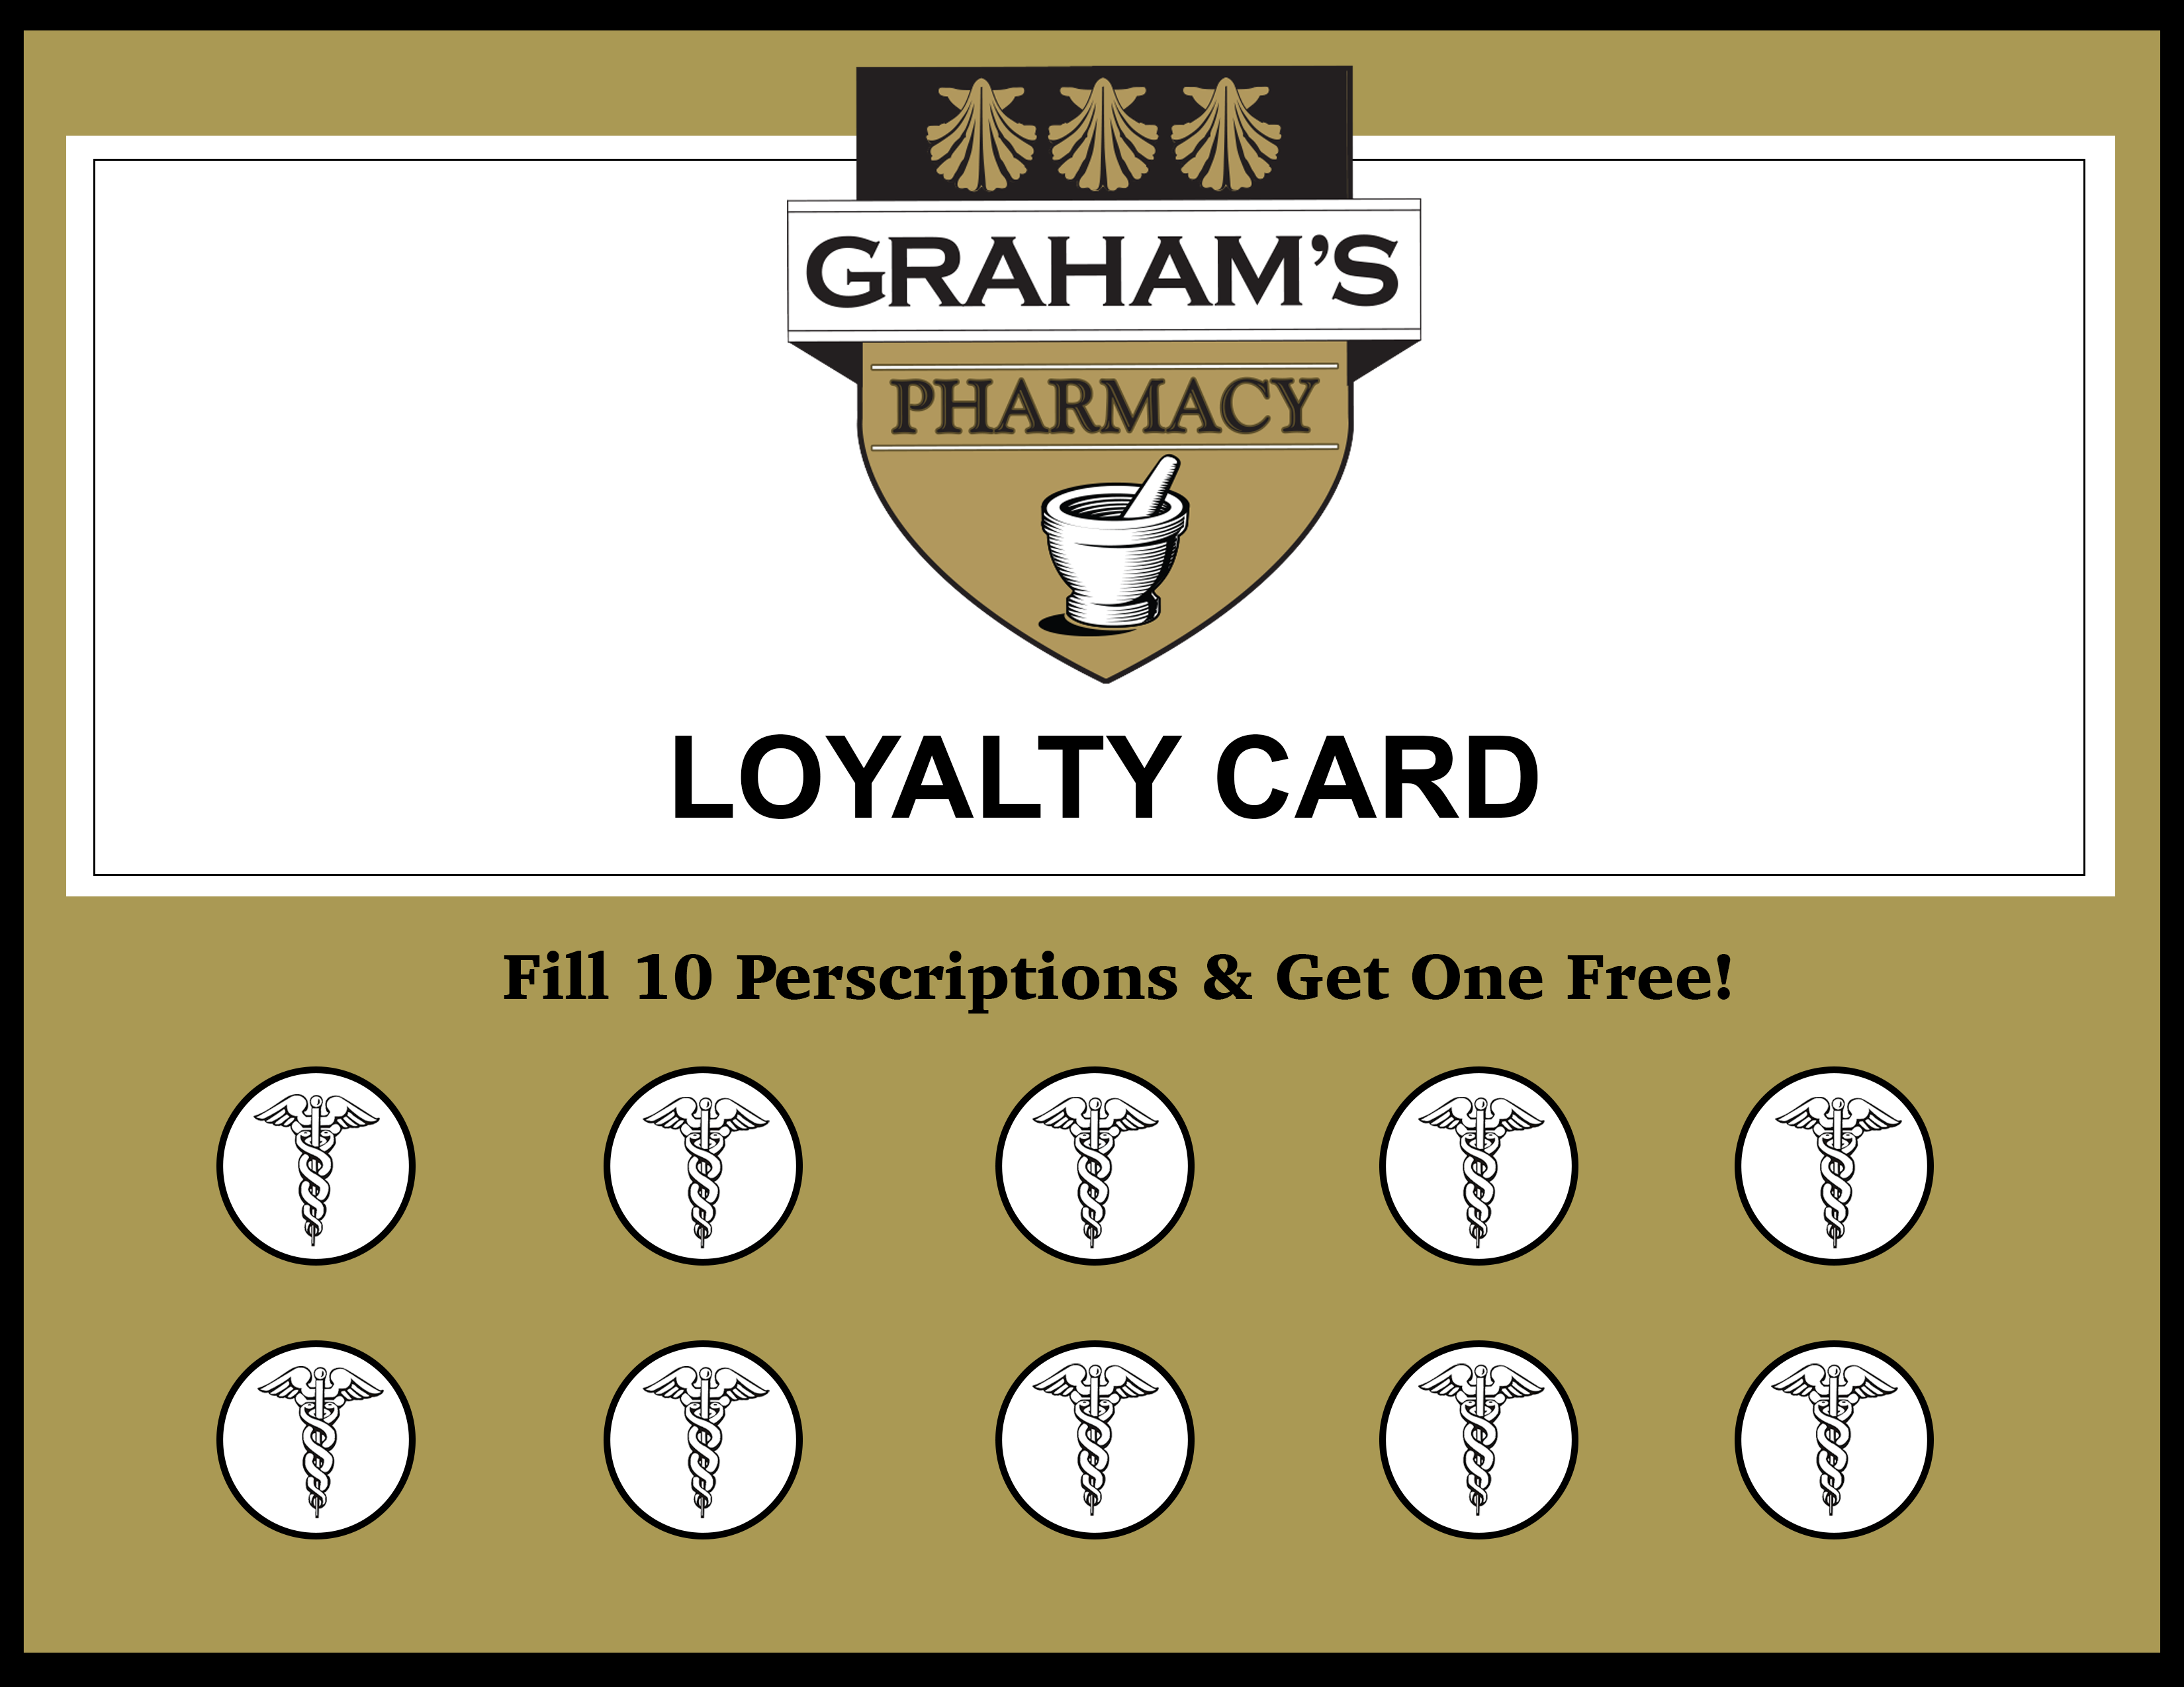

Slide 19
Success = “Know What” + “Know How”
Activity
Months
Problem Identification Analysis Recommendations Implementation Q+A

Slide 20
Key Learnings:
Effective communication to target market segment is needed for effective marketing
More impulsive products at front of house can benefit profit, thus driving customers away from smaller, local businesses towards larger corporations
Increased customer loyalty increased through building meaningful relationships

Slide 21
Our solution will help your Pharmacy keep traditional methods and market effectively to capture more unique market share.
Outcomes
Notes:
For blocks of text greater than 1 line, please expand the text by 0.5pt

Slide 22
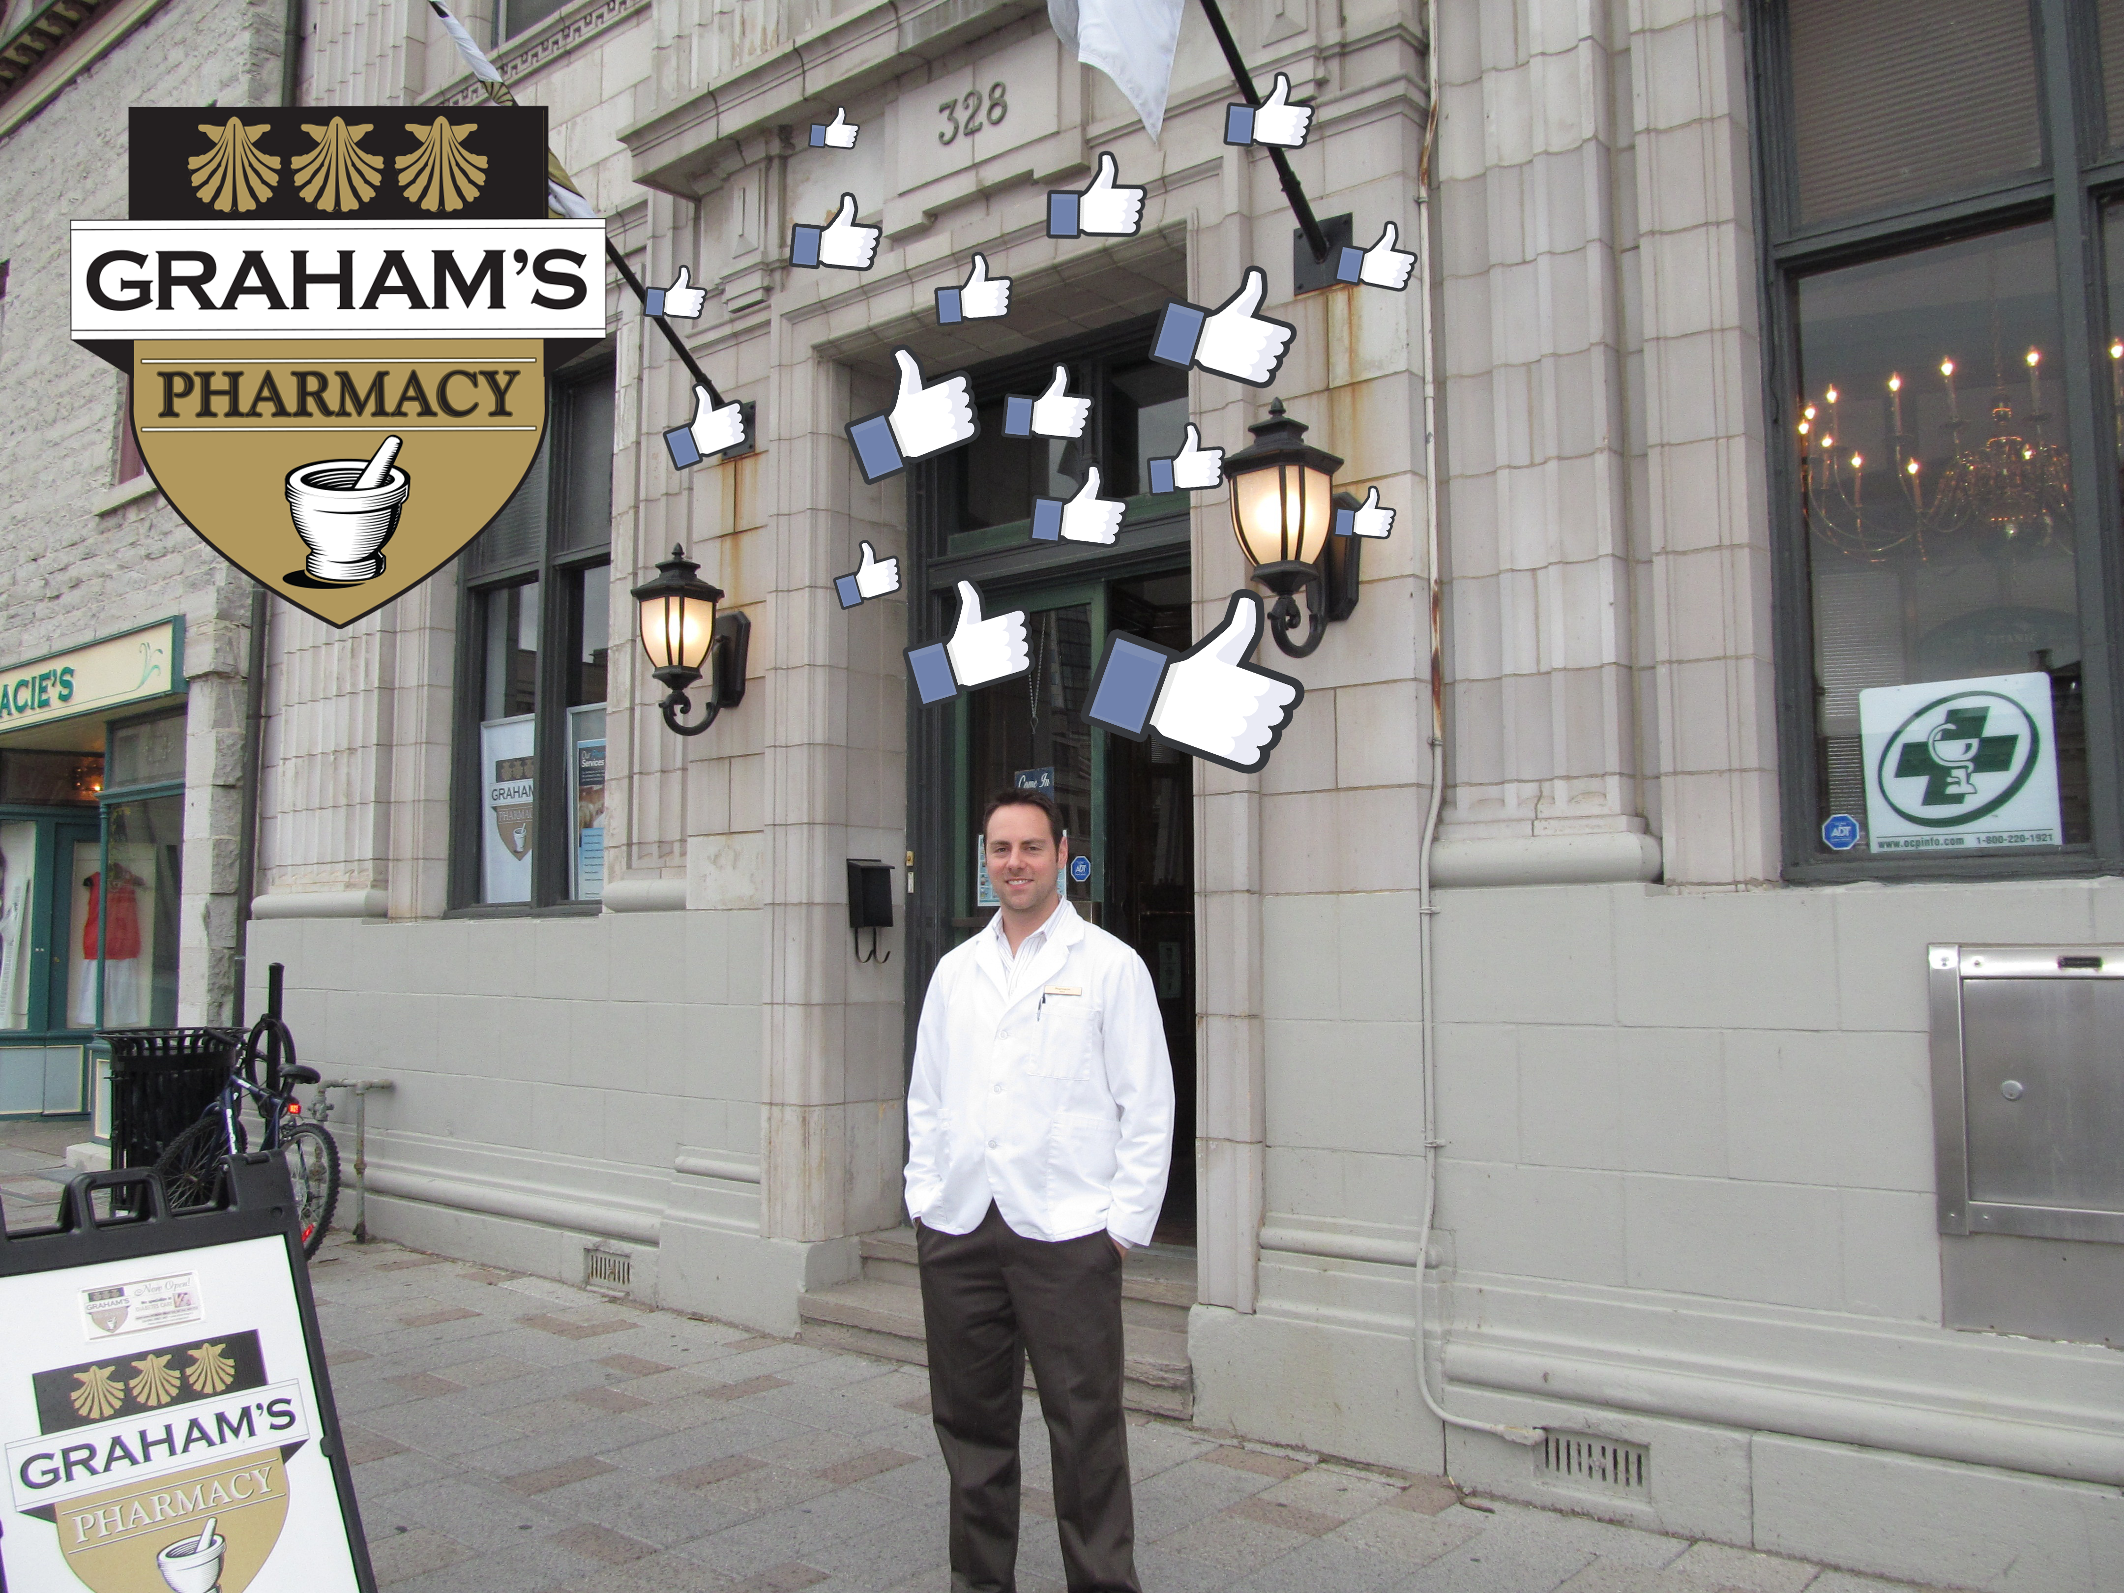
QUESTIONS?

